Slide 2
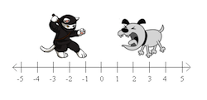
How far apart?

Slide 3
How far apart?

